Slide 1
Loans and Credit
Question 3

Slide 2
Problem
State level differences
Reliability of predictors
USA has 52 states with a lot of variation, between them. Need to know how to approach lending in different states
The ability to predict defaults have a direct impact on profitability and economy
Beliefs
Is our beliefs about what causes higher interest rates and defaults leading us astray

Slide 3
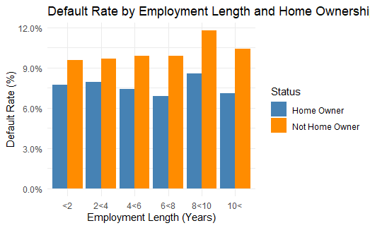
Notes:
This graphs tells us two different stories.
1. That home owners tend to have lower default rates than non-homers.
2. This gap actually increases as people have been longer employed.
The lowest default rate seems to be people who have been employed between 6 and 8 years and owns a home.

Slide 4
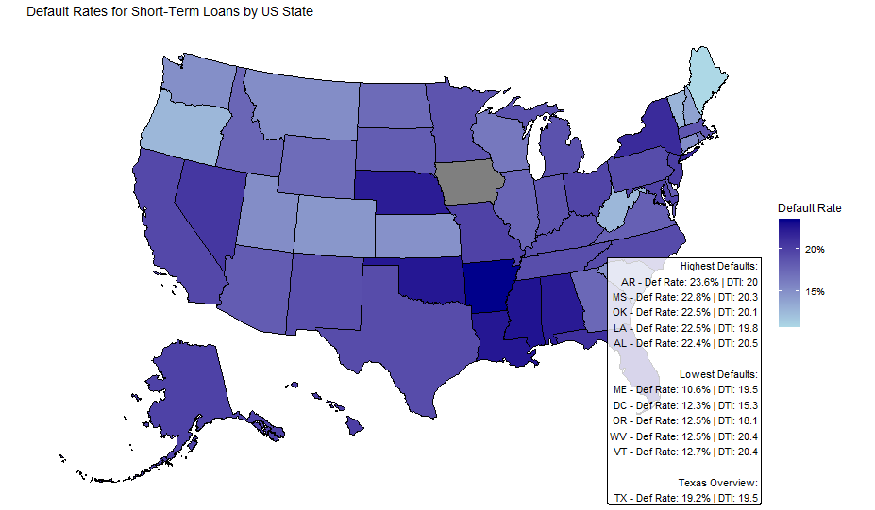
Notes:
From this map we can clearly see that the states with the highest default rates are grouped together down South. While generally the North-West has less defaults with "" having the lowest default rate. Very interestingly DTI levels does not seem to have to great of an impact on defaults. Louisiana has a default rate is higher by 10 percentage points than West-Virginia, but West-Virginia has a higher DTI. So at least on the National level there is no hard level DTI caps, if so there would be no country roads taking you home to the place you belong. Texas is also one of the states with a higher default rate and DTI.

Slide 5
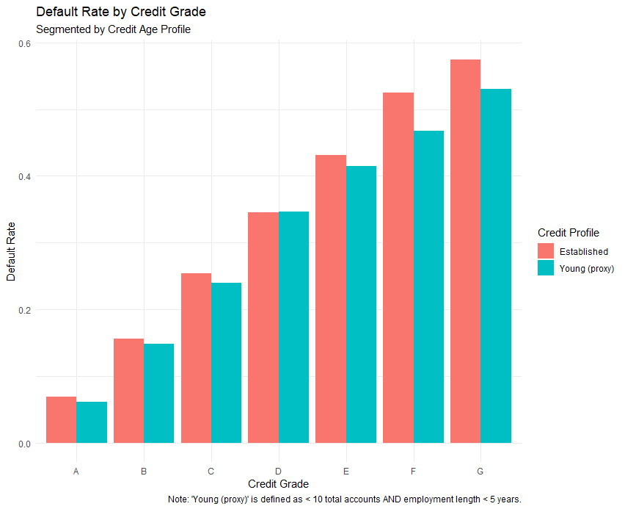
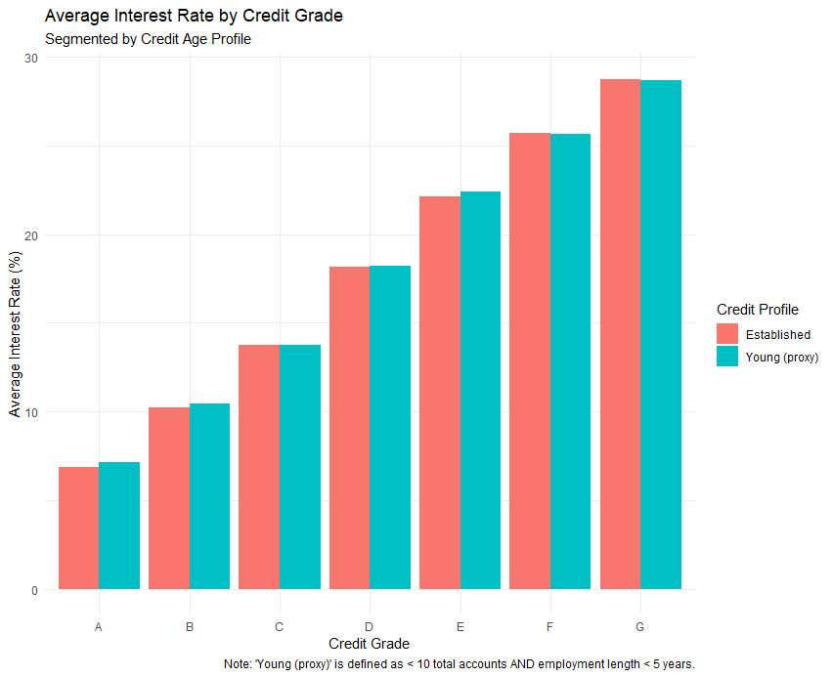
Notes:
As we would expect we see clearly the risk reward trade off (interest rate higher and defaults as grades are worse). We see no difference really in the interest rates between young people and older people (based on our proxy, which is total accounts less than 10 and employment years less than 5). Default rate is just the percentage of people that defaulted. Suprisingly for every grade level we see older people defaulting more than young people.

Slide 6
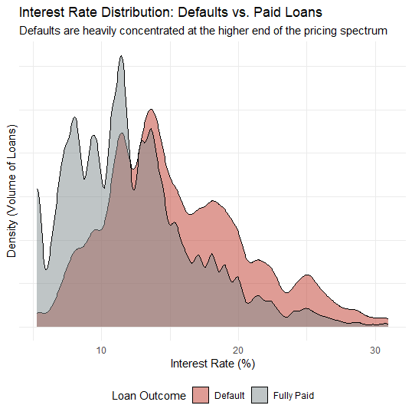
Notes:
The distribution of defaulted loans (red) is visibly shifted to the right compared to fully paid loans (grey). This visually confirms that as interest rates increase, the relative density of defaults rises significantly. The vast majority of successfully "Fully Paid" loans are tightly clustered in the lower pricing tiers, specifically below the 15% interest rate mark.Beyond 15%, the density of successful loans drops off sharply, while the volume of defaults remains elevated, creating a thick "tail" extending past 20%. High pricing captures higher-risk borrowers, but it does not prevent failure.

Slide 7
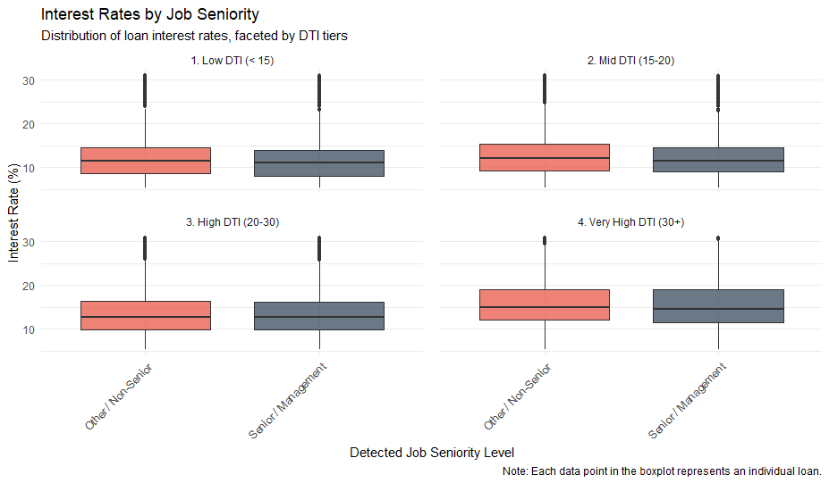
Notes:
Within each individual DTI tier, "Senior/Management" borrowers receive only a very slight discount on their median interest rate compared to "Other/Non-Senior" borrowers. The interquartile ranges (the boxes) are almost identical. The median interest rate visibly shifts upward as the Debt-to-Income (DTI) ratio increases. Borrowers in the "Very High DTI" bucket face noticeably higher baseline pricing than those in the "Low DTI" bucket.

Slide 8
Summary
Credit Grade is King: The fundamentally assigned credit grade remains the most accurate linear predictor of both pricing and eventual failure, drastically outweighing the impact of a "Young/Thin" credit file.
Geographic Risk Pockets: Portfolio risk is not uniformly distributed across the map; there is a distinct, concentrated cluster of elevated default rates isolated in the Southern United States.

Slide 9
Thank you
Mirjam Nilsson​​
206-555-0146​
mirjam@contoso.com​
www.contoso.com​

